Slide 1

Avocado Prices Mini Project
Problem
Avocado is one of the most popular fruits (my favourite), but also one of the most expensive, so this mini project aims to get insights about how the price of avocado is affected by different factors and also to predict the future of avocado prices by using machine learning.
Questions to answer:
Which is the month and season with the highest and lowest price of avocado?
Which region has the lowest and highest prices of Avocado?
What is the region with the highest and lowest avocado production?
What is the average avocado prices and volume for year?

Slide 2
Dataset
Source: https://www.kaggle.com/
Data shows information about price, sales and volume of avocado produced in the regions of US.
AveragePrice: the average price of a single avocado
Total Volume: Total number of avocados sold
Total Bags: Total number o bags
Small Bags: Total number of Small bags
Large Bags: Total number of Large bags
XLarge Bags: Total number of XLarge bags
type: conventional or organic
year: the year
region: the city or region of the observation
4046: Total number of avocados with PLU 4046 sold
4225: Total number of avocados with PLU 4225 sold

Slide 3
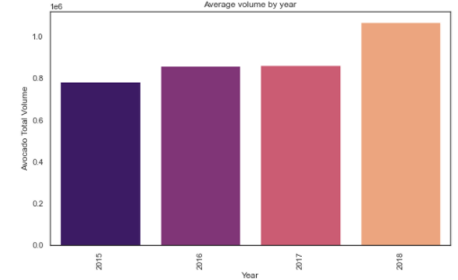
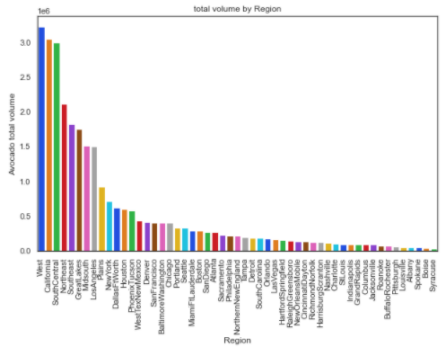
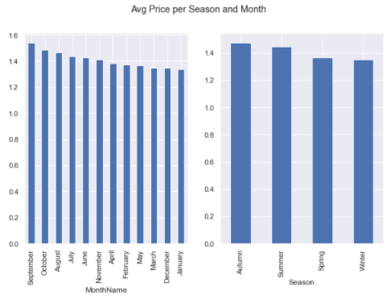
Results of EDA
Autumn is the season with the highest price of avocado and September is the month with the highest price.
Hartford Springfield is the region with the highest price for avocado and Houston offers cheaper avocados.
The west is the region that produce the greatest amount of avocados and Syracuse is the one that produce the fewest avocados
The volume of avocado has increased over the years and the price has remained between $1 and $1.5

Slide 4
Database type
SQLITE database was chosen due to the following:
My data is structured and organized
Querying the data is easier with SQL as the data is well structured and organized

Slide 5
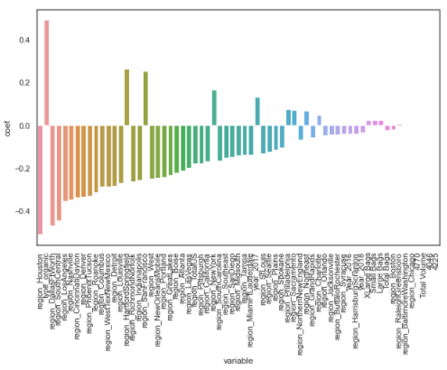
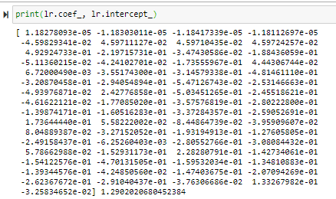
Machine Learning (ML) model definition
The model chosen is Multiple linear regression.
Inputs:
Target Variable: Average price of avocado
Predictor Variables: Total Volume, Total Bags, small bags, large bags, type, region, month.
Outputs:

Slide 6
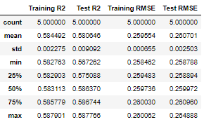
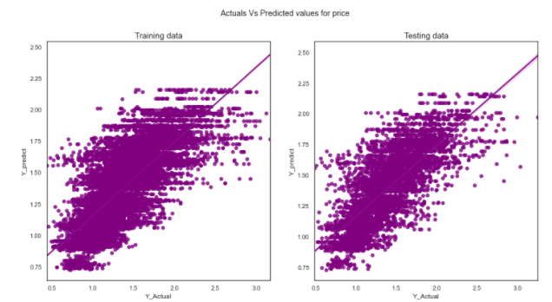
Results from training & testing
The model chosen explains the data appropriately. Data points are closer to the regression line.
R2 and RMSE indicates that the model could have a good fit.
R2: 0.58
RMSE: 0.06
Cross validation

